Slide 1
Iterative Methods
PHYS3112 – Tutorial 5

Slide 2
Today we will:
Beginner Level
Intermediate level
Learn about iterative structures (for loop, while loop)
Perform a basic iterative computation (single variable)
Learn the finite-difference approximation
Numerically integrate an ODE (without using ODE int!)
Advanced Level
Learn the tri-diagonal matrix formulation for DEs
Solve Poisson’s equation in ID using matrices and inbuilt routines

Slide 3
Iterative Methods - Motivation
Iterative methods are what computers are REALLY GOOD AT:
Some simple calculation that needs to be repeated with small differences in input.
ODE int (from tutorial 3) is actually an iterative method! It’s just hidden inside the ODEint function so you don’t get that experience.
It’s useful for simulations of time-evolving systems, or spatially varying systems.
The principal complication is the degree to which each iteration depends on the value of the iteration before it.

Slide 4

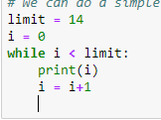
The For and While Loops
These loops allow us to repeat a computation a set number of times.
For loops allow us to do things a certain number of times
While loops allow will keep going while something is true

Slide 5
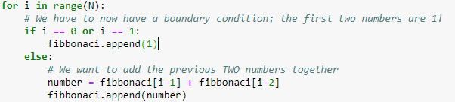
Iterating through time; continuous updates
Instead of simply repeating a calculation, we can iterate through time/space to make evolving calculations. Usually this involves each calculation using the data from a previous calculation.
Eg, fibbonaci sequence;
The most common way to do this is for time-evolving systems, where the current state depends slightly on the previous state.

Slide 6

Intermediate starts here
We’re going to numerically simulate the following differential equation:
We’re NOT going to use ODE-int this time, because we are using this to develop our simulation skills (and we will soon hit problems for which ODEint is useless).
Strategy: 1. Determine our discretisation regime 2. Determine how to ‘step’ across our regime 3. Set up function(s) that will ‘step’ as we wish 4. Put functions in loops, iterate and solve
$$\frac{dx}{dt}=\frac{sin⁡(t)}{t}$$

Slide 7
Discretisation and Step Relationship
Hopefully you should realise that if we’re evaluating x(t) from the equation below, we need to define a range of t’s that we’re going to be using.
You need to ask;
How large a range will you be considering?
How small does the step size in t need to be?
The answer for 2 will probably come from our stepping function

Slide 8

Stepping functions
$$\frac{dx}{dt}=\frac{sin⁡(t)}{t}$$
Our goal is to turn into a formula relating our current value for x at time T, to past values for x at time t < T.
Because our simulation will be performing in discrete time steps, we want to relate the current value for x to previous values for x.
In short, we want to know; what is the relationship between x(tn) and x(tn-1), x(tn-2) etc?
If we know this, then we can always evaluate x(t=T) by using our previous values of x(t<T). This is how iterative methods are done.

Slide 9




Determining the step function
$$\frac{dx}{dt}=\frac{sin⁡(t)}{t}$$
Let’s do a first order, finite-difference approximation of the derivative:
Which we can then extend:
And we get our step-function!
$${\left(\frac{dx}{dt}\right)}_{n}=\frac{x\left(t_{n}\right)−x\left(t_{n−1}\right)}{Δt}$$
$${\left(\frac{dx}{dt}\right)}_{n}=\frac{x\left(t_{n}\right)−x\left(t_{n−1}\right)}{Δt}=\frac{\sin\left(t_{n}\right)}{t_{n}}$$
$$x\left(t_{n}\right)=x\left(t_{n−1}\right)+Δt×\frac{\sin\left(t_{n}\right)}{t_{n}}$$

Slide 10
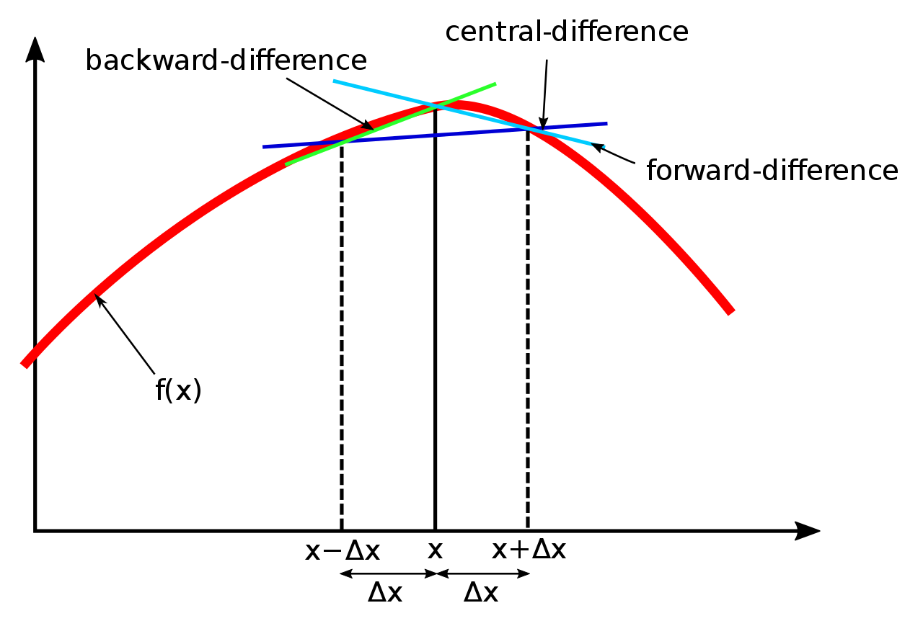
Notes on step function
Obviously this is more accurate at small timesteps (delta t)!
There are better numerical approximations of derivatives out there, I have used the simplest one.

Slide 11
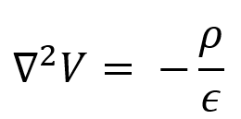
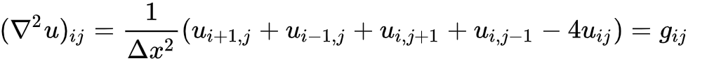
Advanced – 1D Poisson Equation
Sometimes, a DE can’t be solved by simply iterating one thing after another.
An example of this is the Poisson equation:
Which has a 2-D stepping function:
(See week 5 lecture notes for how this sort of stepping function is derived)

Slide 12
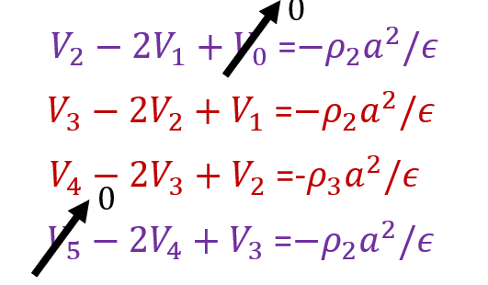
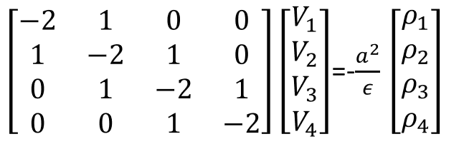
The Tridiagonal Matrix
If you arrange the stepping function into a series of equations, you’ll yield a matrix:
(Again, refer to week 5 lectures; these are just screenshots!)
1
4

Slide 13
How do we solve it?
There’s a rather nice algorithm called the ‘Thomas Algorithm’ that is computationally efficient. Specifically works for tridiagonal matrices.
However, we can simply do matrix inversion in python. (note; this is very inefficient for large data sets!)

Slide 14
Example – Matrix Inversion
Matrix inversion is pretty easy.
If you have your Poisson matrix (A) and your rho-vector (B), then the voltages (V) at each point are the solution to the equation AV = B.
This can be easily solved using numpy’s linalg solver; numpy.linalg.solve(A,B) will return V.

Slide 15
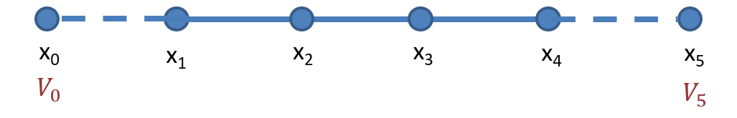
Boundary conditions – Edge Voltage (Dirichlet Boundary condition)
A key thing to be able to do is to modify your poisson matrix to account for boundary conditions.
For example, what if the edge values of voltage are constrained to be a certain value?
This introduces two extra terms: V0 and V5 into our (four by four) matrix. Do we now have a 6x6 matrix?

Slide 16
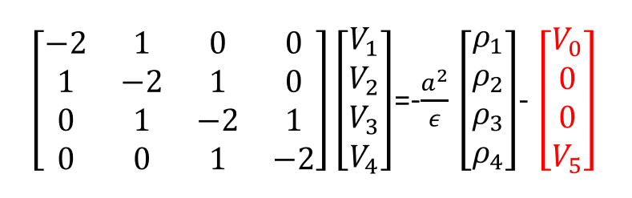
No! Because V0 and V5 only show up once apiece, we can modify their sections of the matrix only:
So we can complete these boundary conditions by modifying the rho vector. (again, derivation shown in lecture)

Slide 17
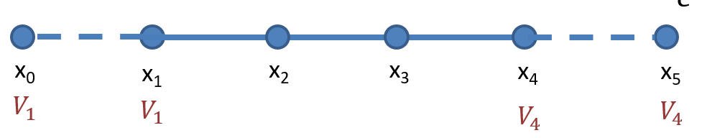
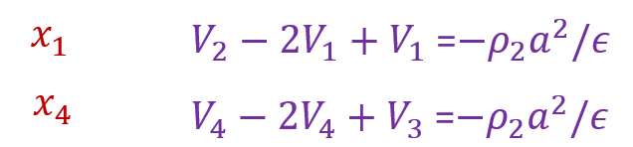
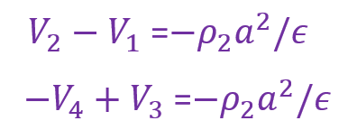
Boundary Condition: Constant Gradient (Neumann Boundary condition)
We can also specify the gradient at the boundaries of our simulation. This is equivalent to fixing the relationship between the edge values and the off-edge values.
This changes our equations!
becomes

Slide 18
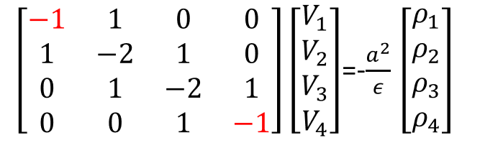
Finally, we get a matrix simplification

Slide 19
Your tasks
Make your way through the advanced tutorial notebook, and ensure you understand the process of matrix solving.
Go through lecture notes and try to understand how the Poisson matrix is derived (and ask me for help!)
Experiment with a variety of boundary conditions; for example, what if the gradient was set such that V1 = 2V0? How would that change the Poisson matrix?

Slide 20
Further steps
So far this is still only 1D
We have fixed our Step size (a) to be constant for all positions in our mesh
It is time constant
Other questions / comments? Please let me know! There is a lot of ground that can be covered and I’m unsure as to what you would like.

